Slide 1





Webflow Livestream
June 5, 2024
Storytelling for the Web
Integrate storytelling to create memorable experiences
Chiara Aliotta
Brand Designer and Strategic Storyteller

Slide 2
Who in the world am I?
Ah, that's the great puzzle.
Alice in Wonderland, Lewis Carroll

Slide 3



ALWAYS OPEN
24/7

Slide 4


A LWAY S 0 P E N

Slide 5
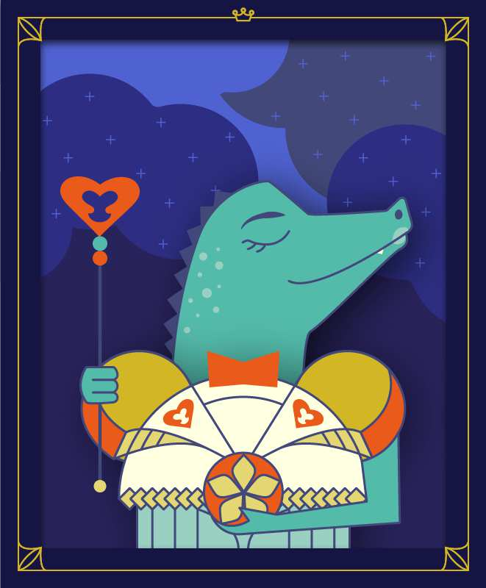









Slide 6
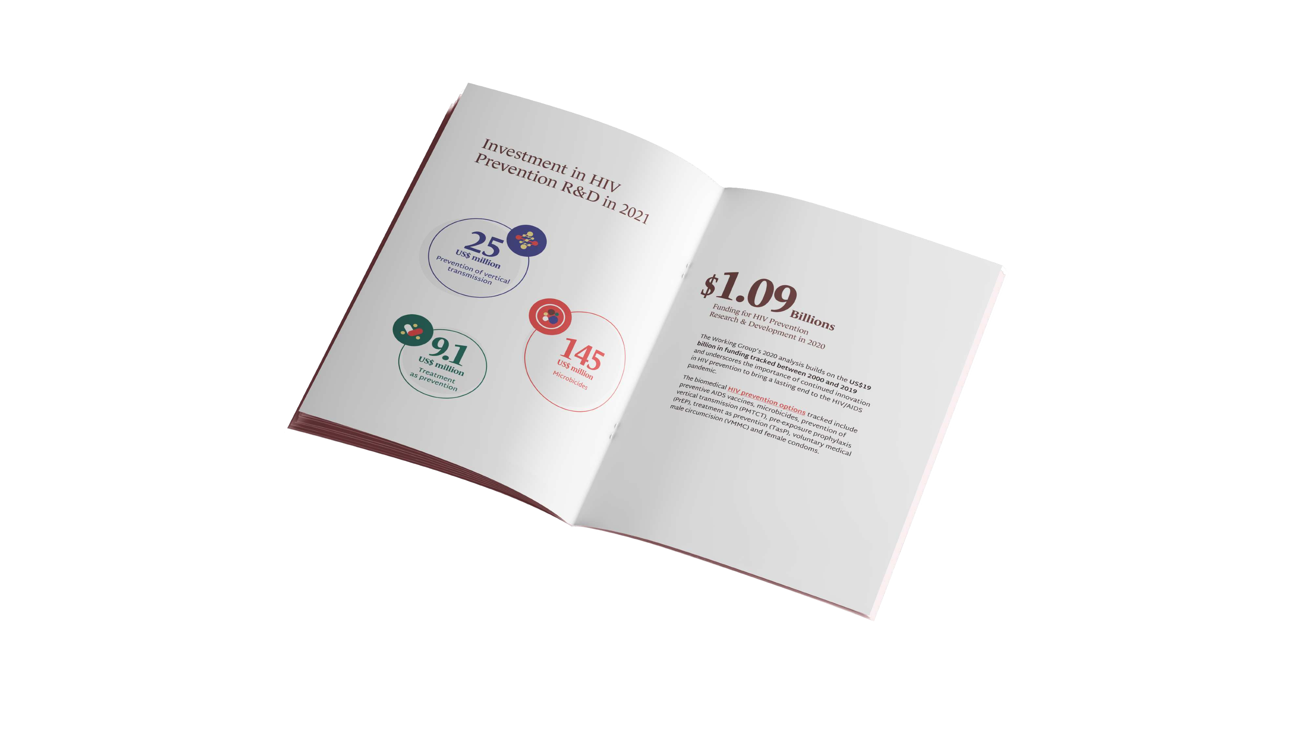


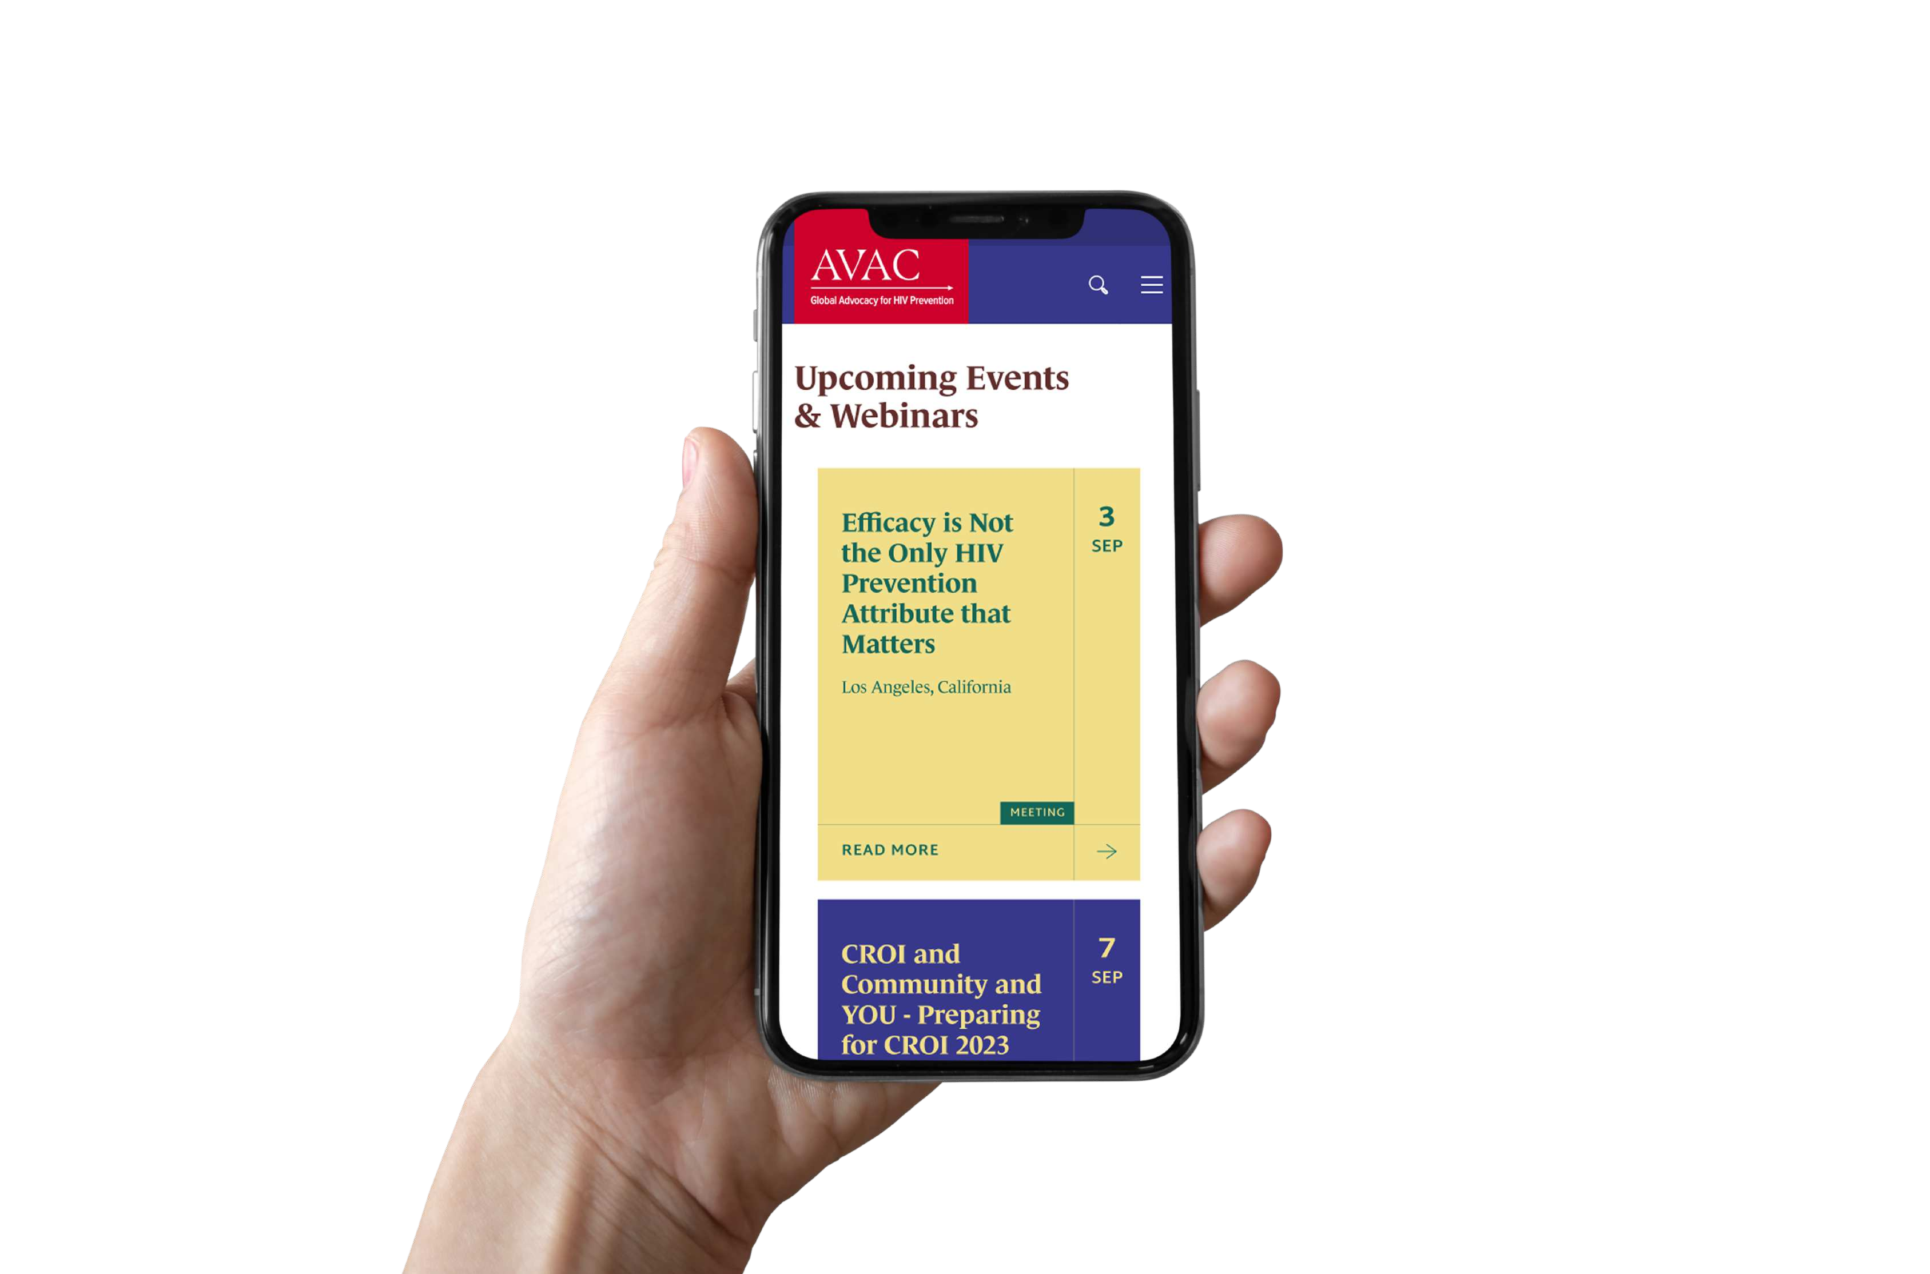

Slide 7

Storytelling is a process

Slide 8
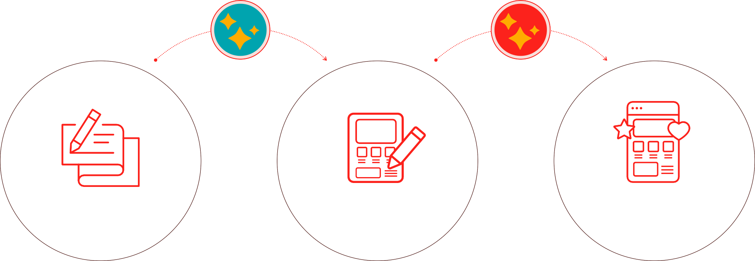
Ue Storytelling Process for Designers
How designers can integrate storytelling in their design process.
BRIEF
DESIGN
DELIVER
the client
the user
the user + the client
Storytelling is a Process

Slide 9
First encounter with the client.
Gather all the essential information to create a comprehensive brief.
BRIEF
The Foundation
Craft the story’s foundation.
Write down the project’s objectives, scope, and requirements. It’s like the plot outline that sets the stage for everything that follows.
Storytelling is a Process

Slide 10
Ue Fundamentals of Storytelling
02
THE PURPOSE
+ RESOLUTIONS
The main reason behind your story
and your protagonist’s transformation.
04
01
06
THE INTERACTIONS
THE AUDIENCE
The main protagonist of your story.
The interfaces that propel the action.
THE EMOTIONS
+ TONE OF VOICE
03
05
The emotional connection with the audience.
THE CHARACTERS
The components that the user engages with.
THE CONTEXT
The rhythm of the story.
Storytelling is a Process

Slide 11







Tell me about your project!
Who is your brand/project for?
What is your project about?
Why are you designing it? How do users interact with it? Where do you use it?
How should the user feel?
Audience: Users
The Characters: Product / Brand / Service
The Purpose + Resolutions: Mission / Vision The Interactions: Functionalities / Features The Context: Platforms / Medium
The Emotions + Tone of Voice: Emotional connection
Storytelling is a Process

Slide 12

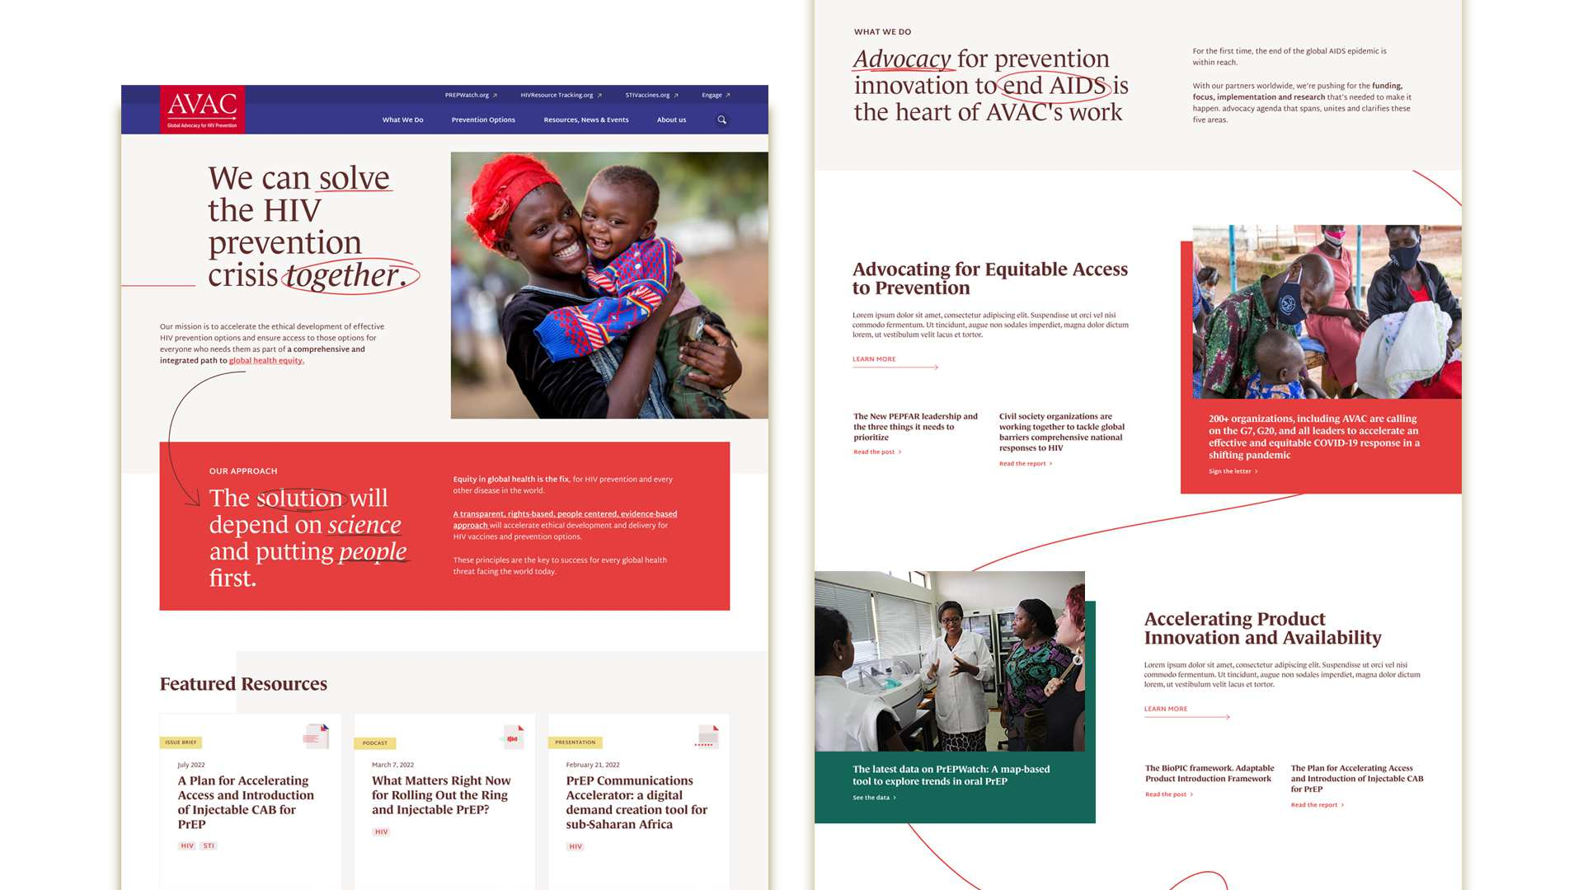
AVAC
Redesign of the organisation’s digital presence

Slide 13





AVAC
Redesign of the organisation’s digital presence
Presentation
Article
Factsheet
PX Wire
Video
Newsletter
Brochure
Blog Post

Slide 14




AVAC
Redesign of the organisation’s digital presence

Slide 15
Start with the user.
Focus on the audience, understanding their needs, goals, and pain points.
DESIGN
Building
the Narrative
Map out the user journey as a story.
Storytelling helps us visualize the users’ journey and how they will interact with our product.
Storytelling is a Process

Slide 16













Ue Structure of a Story
Based on Donald Miller's StoryBrand structure.
What did they achieve?
Who is their guide?
How would they put their plan into action?
Users
What plan did they have?
What is their quest?
PROTAGONIST
PROBLEM
GUIDE
PLAN
ACTION
SUCCESS
(or failure)
THE PLOT
Storytelling is a Process

Slide 17


Ue Narrative Structure
Based on Aristotle’s three-act structure
CLIMAX
PLOT POINT 2
PLOT POINT 1
MIDPOINT
INCITING INCIDENT
THE PLOT
SETUP
CONFRONTATION
RESOLUTION
Storytelling is a Process

Slide 18




Ue Narrative Structure for Digital Products
Smart Interface Design Patterns
Success / Failure
Designers
Vitaly
Plan
Problem
Actions
Climax
Midpoint
Inciting Incident
Plot Point 1
Plot Point 2
THE PLOT
SETUP
CONFRONTATION
RESOLUTION
Storytelling is a Process

Slide 19

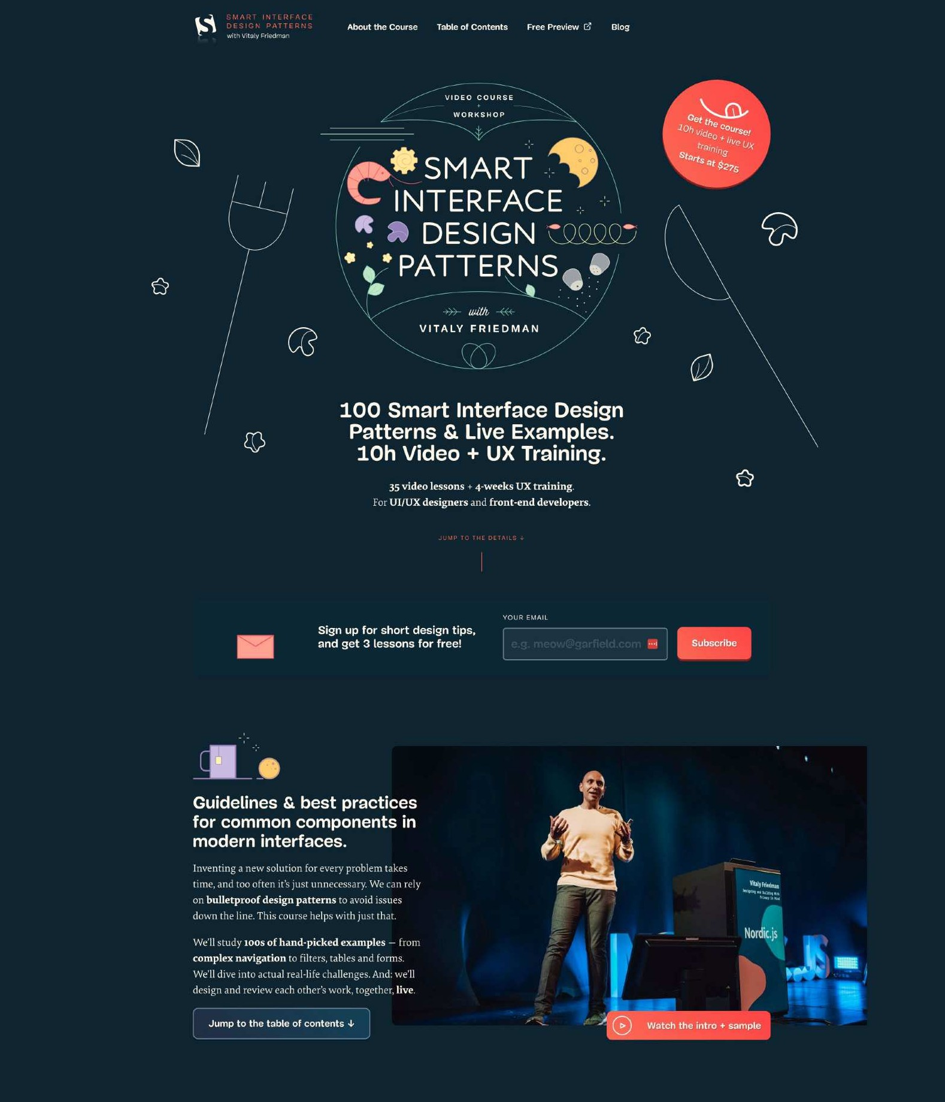
Landing Page for Smart Interface Design Patterns
https://smart-interface-design-patterns.com/
OPENING SCENE
End of opening scene Beginning of middle scene
MIDDLE SCENE
Storytelling is a Process

Slide 20

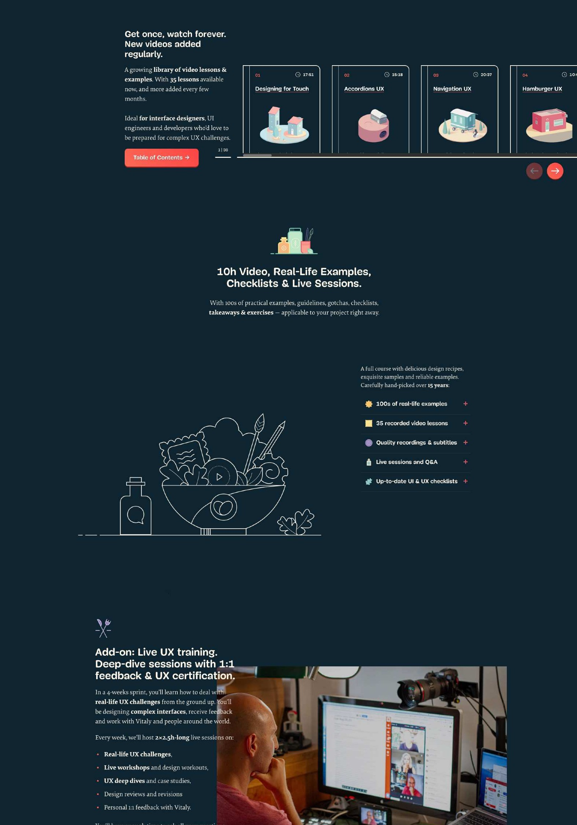
Landing Page for Smart Interface
https://smart-interface-design-patterns.com/
Design Patterns
MIDDLE SCENE
Storytelling is a Process

Slide 21
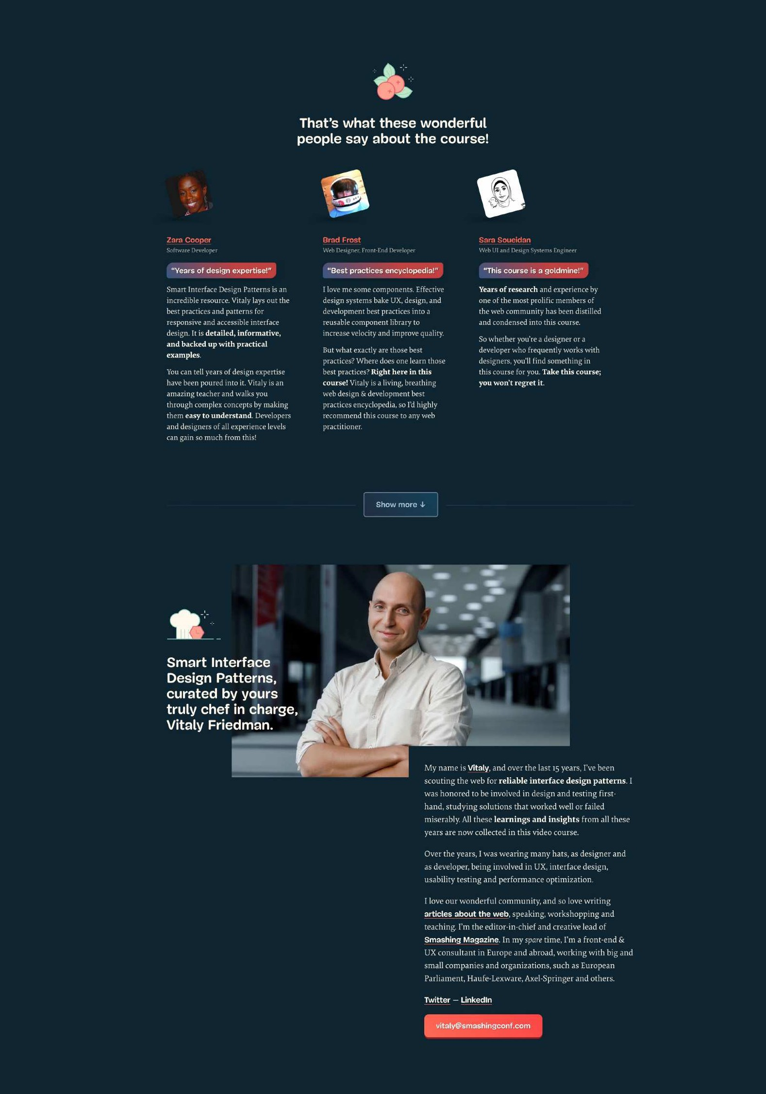
Landing Page for Smart Interface
https://smart-interface-design-patterns.com/
Design Patterns
MIDDLE SCENE
Storytelling is a Process
End of middle scene

Slide 22
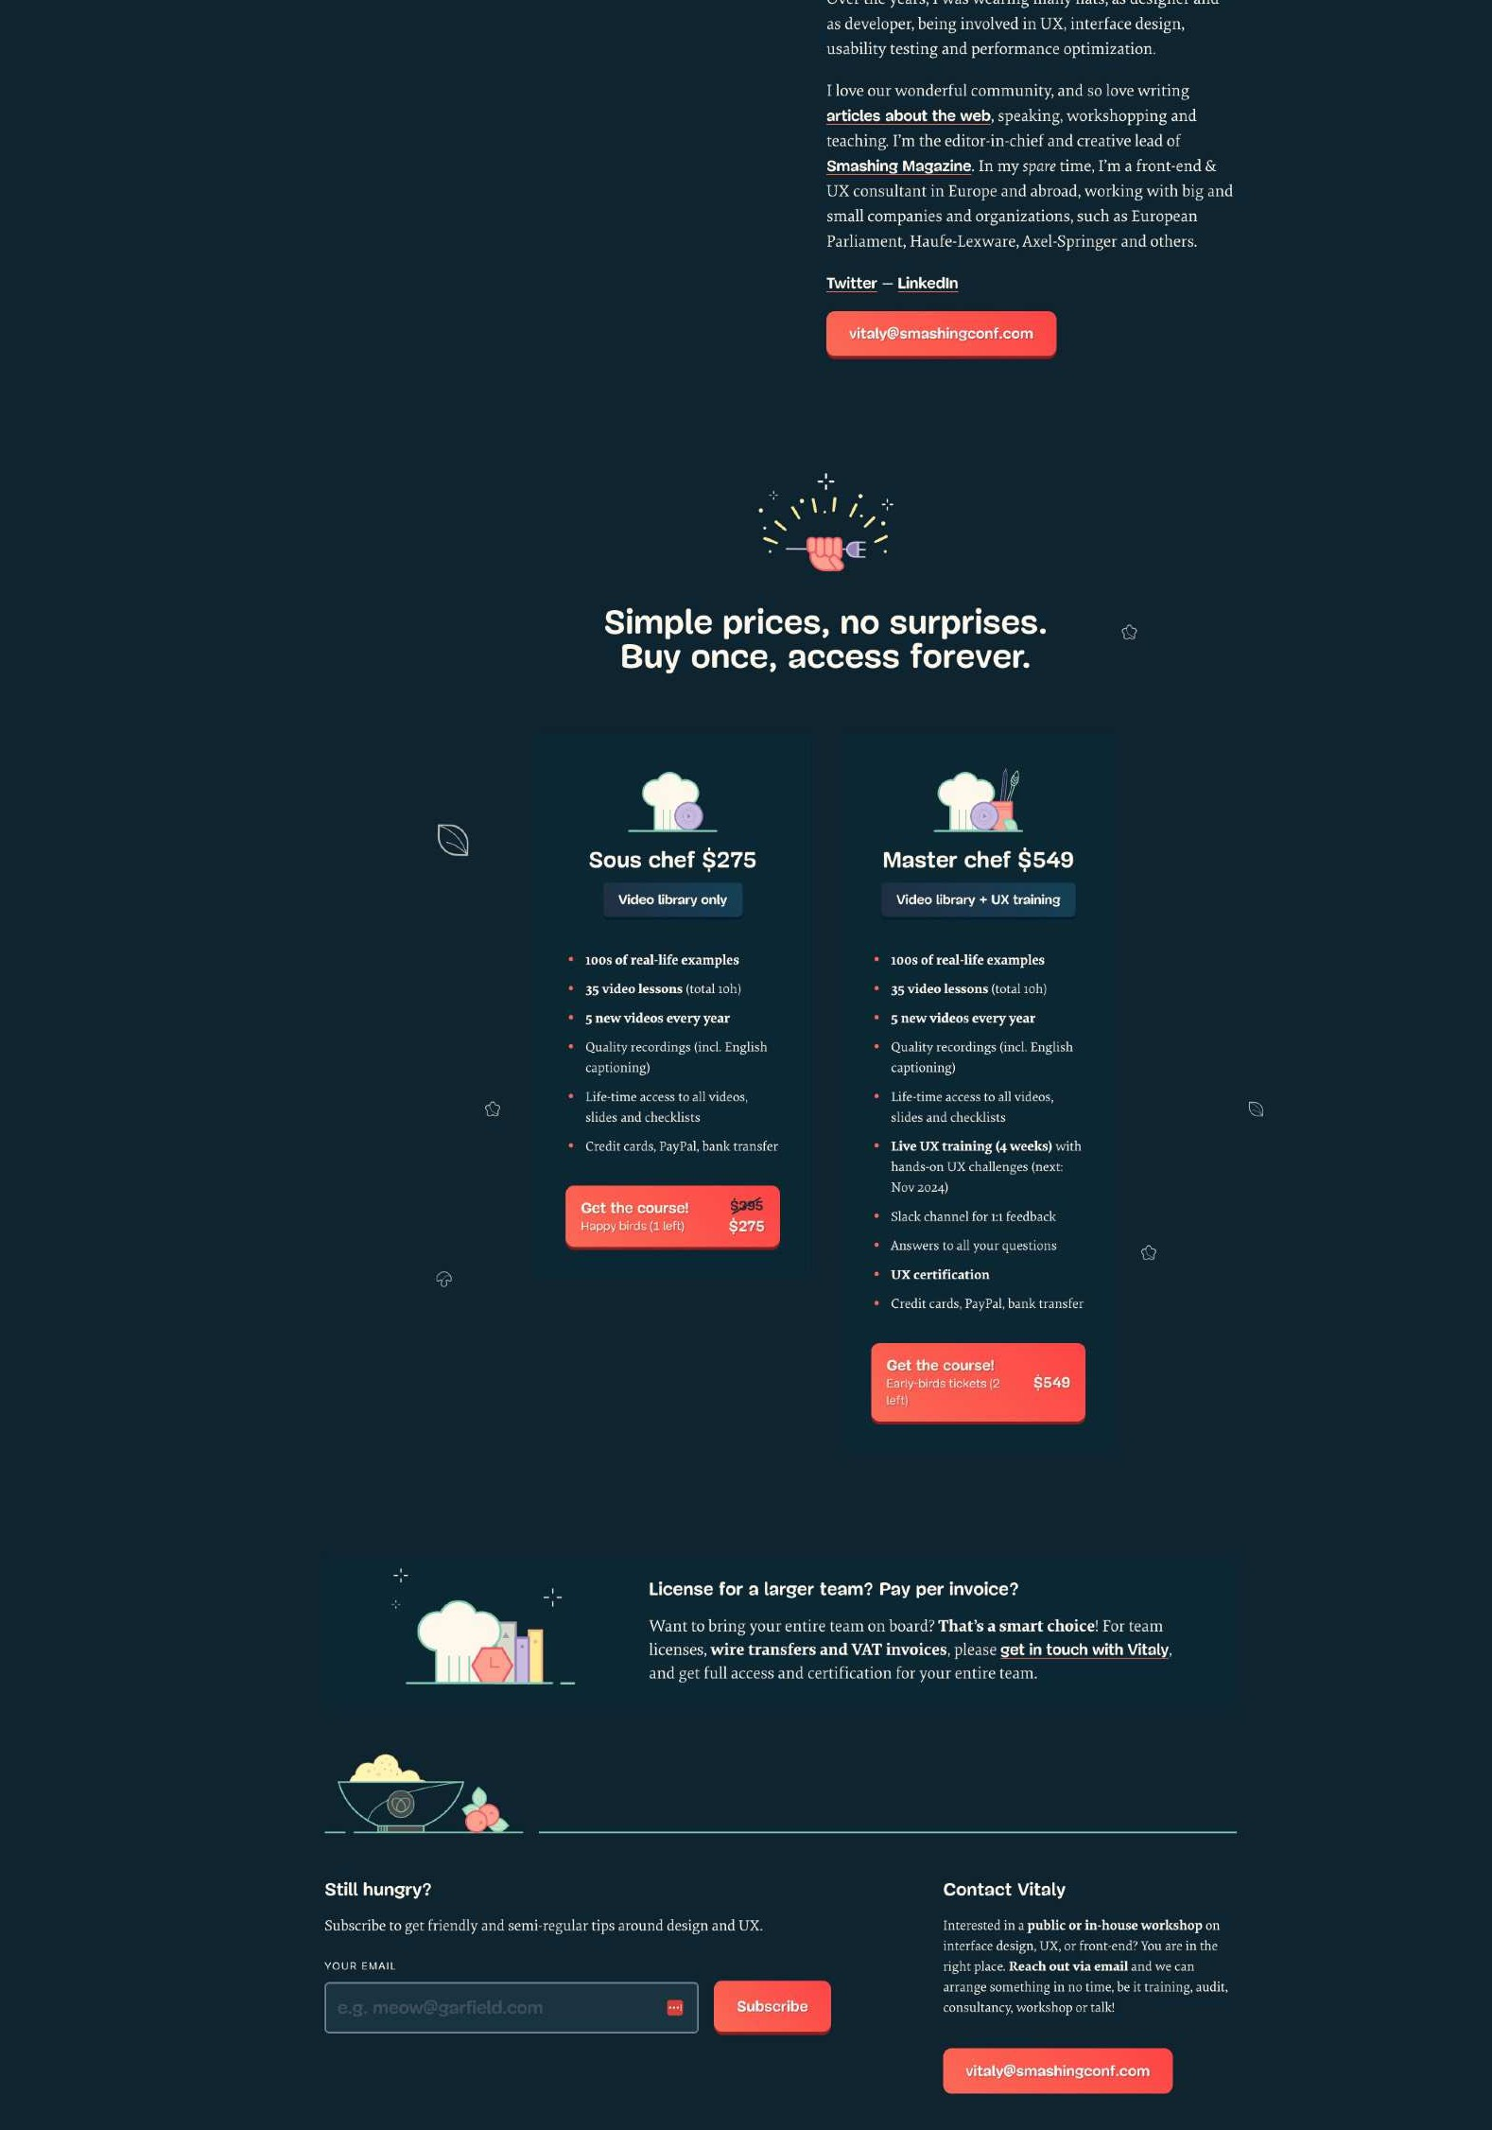
Landing Page for Smart Interface
https://smart-interface-design-patterns.com/
Design Patterns
End of middle scene Beginning of closing scene
CLOSING SCENE
Storytelling is a Process
End of closing scene

Slide 23
Present ideas, persuasively.
Storytelling allows us to frame our concepts in a way that resonates emotionally, making our proposals more compelling.
DELIVER
Create a lasting impression
Connect with the end users.
Creating an emotional connection is what transforms a good design into a memorable experience.
Storytelling is a Process

Slide 24
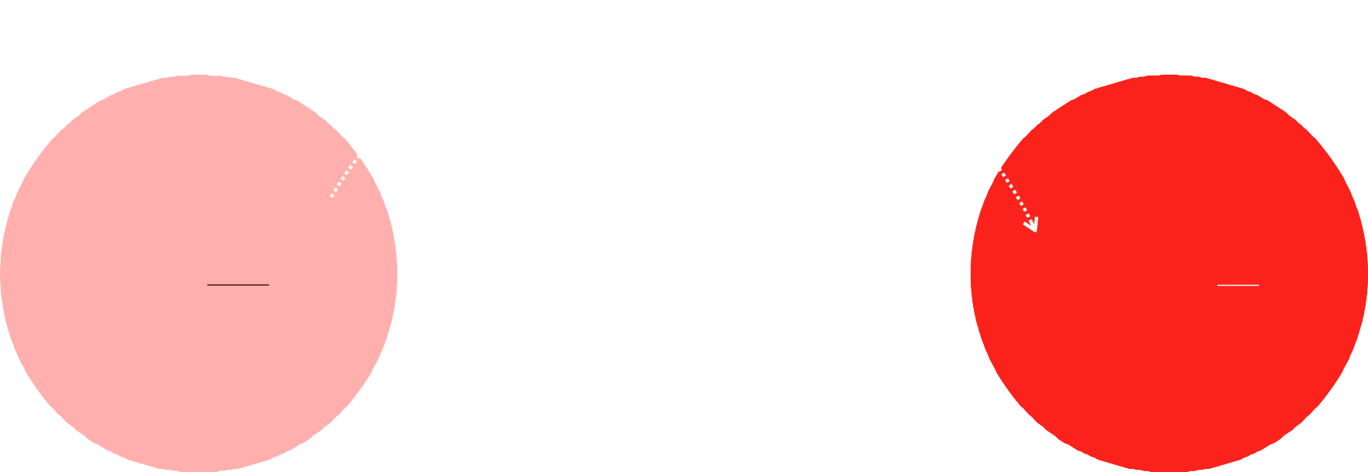
Ue Transformative Journey
Understanding the character arc
CHANGE HOW THEY SEE SOMETHING
Exploring different aspects of the story such as characters, challenges, interactions and emotions.
CHANGE HOW THEY FEEL
ABOUT SOMETHING
MAKE THEM WANT TO DO SOMETHING
THE PROBLEM
Challenges & Desires
RESOLUTION
Solutions & Achievement
Storytelling is a Process

Slide 25
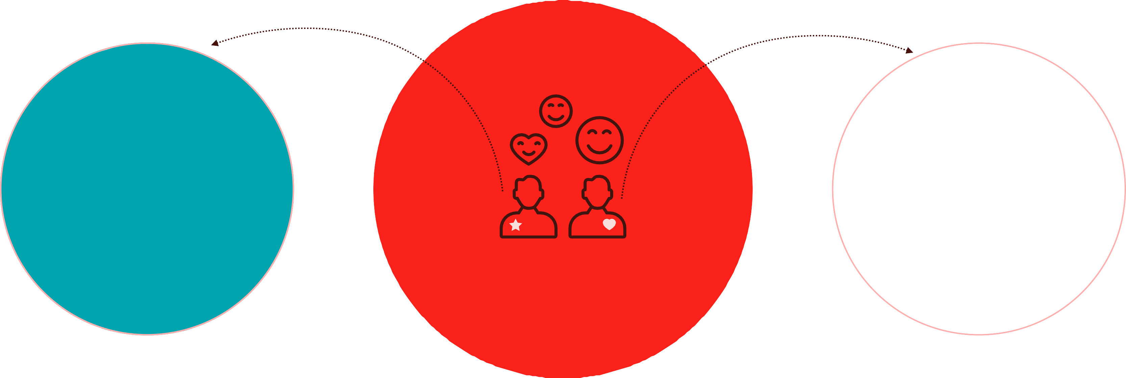
Consider your audience
Understanding their goals and needs
CLIENT
USERS
DELIVER

Slide 26


To sell
Sell or validate a product or service against others in the market.
To motivate
Offer compelling and appealing solutions, ideas, products, and services that can make a positive impact on one's life.
The purpose
The why of the story…
To persuade
Present intangible concepts like values and thinking processes through stories.
Storytelling is a Process

Slide 27
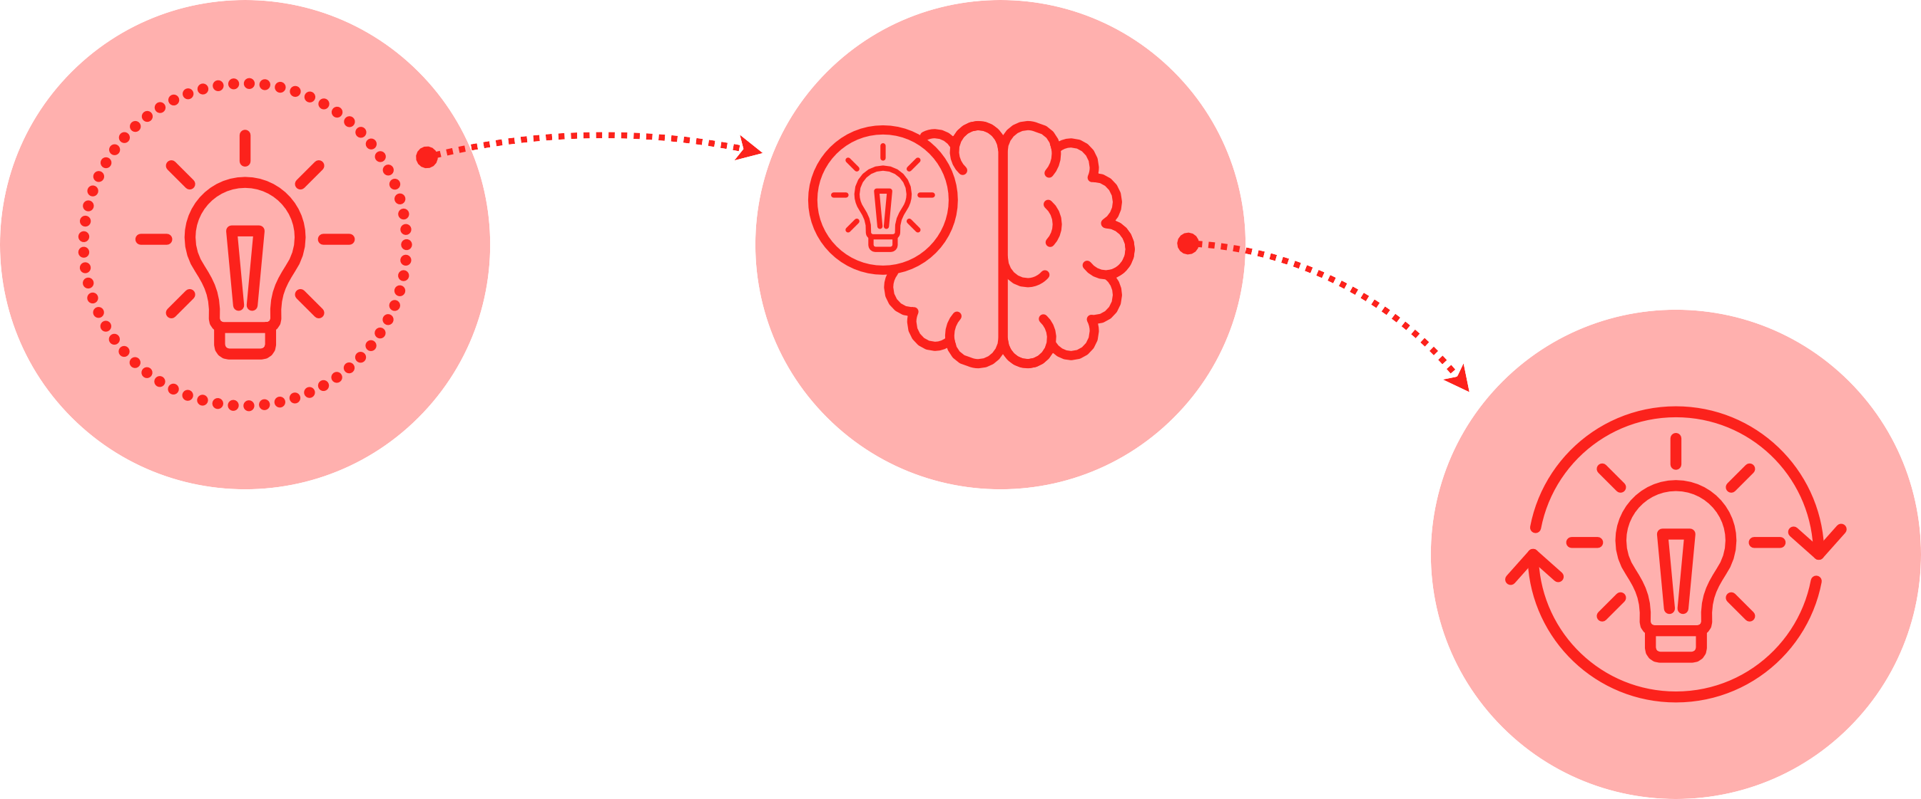
A Journey of Transformation
Four steps to persuade, “engage” and change “minds” according to Lisa Cron (Story or Die)
TRUTH
Inciting Incident
REALISATION
Climax
MISBELIEF
Problem
TRANSFORMATION
Resolution
Storytelling is a Process

Slide 28




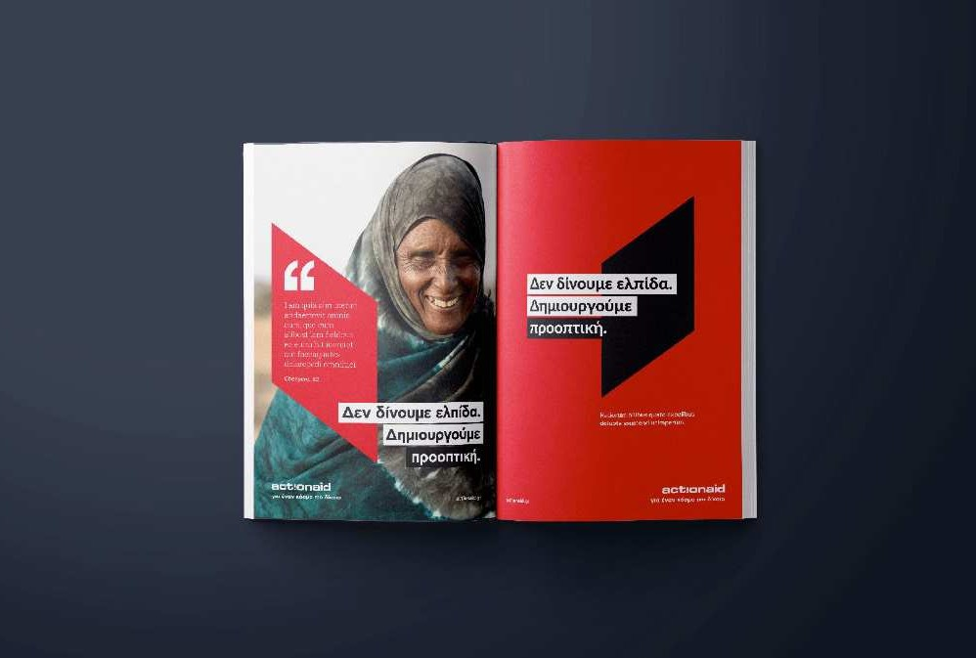

To persuade the organisation to rebrand
Action Aid Hellas (2021)
TRUTH
Your organisation's communication style is not distinctive
from that of others.
REALISATION
We should focus on ways to distinguish ourselves from others.
TRANSFORMATION
Our organisation requires a revised communication and branding strategy.
MISBELIEF
Our approach is unique and distinct from the rest.
Storytelling is a Process
Read the case study: https://tinyurl.com/3fk5mc4n

Slide 29

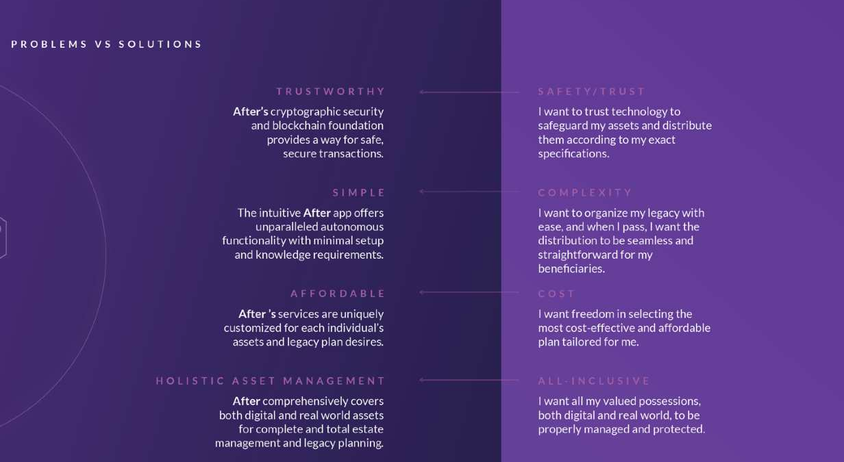


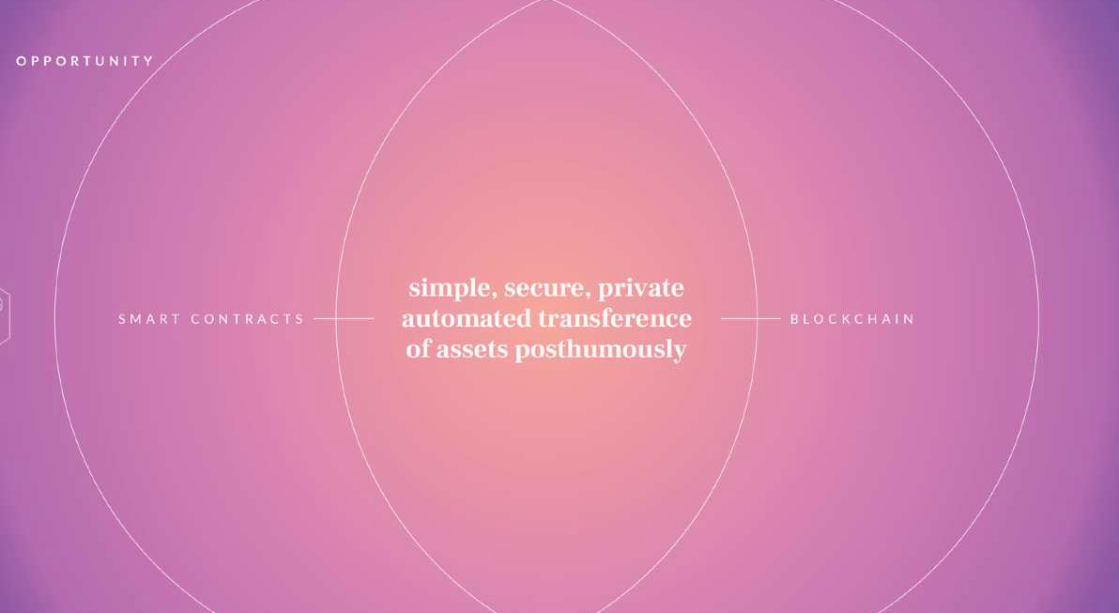
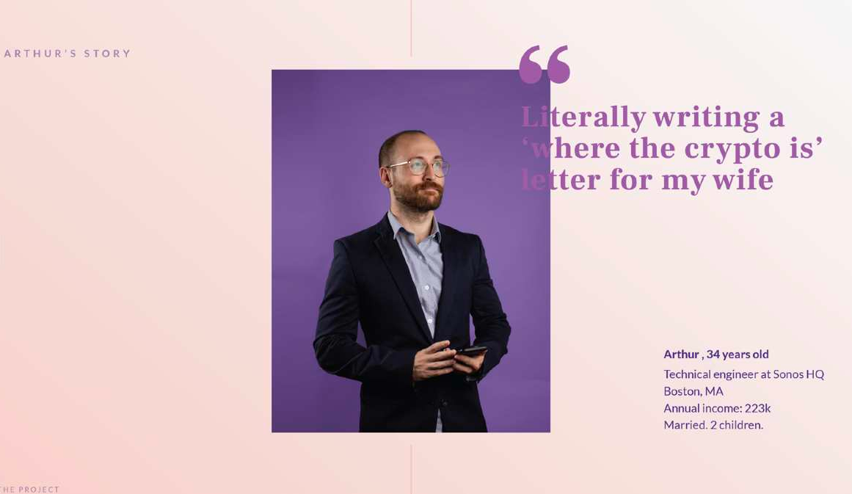
To motivate investors to fund the product
After App (2021)
TRUTH
What happens if, after departure, the letter doesn't get executed or the instructions are unclear?
REALISATION
We should find a way
TRANSFORMATION
Our solution comprehensively covers digital and real-world assets
for complete estate management and legacy planning.
to safeguard our assets.
MISBELIEF
All my valued possessions are properly managed and protected.
Storytelling is a Process
Read the case study: https://tinyurl.com/4ust8r97

Slide 30
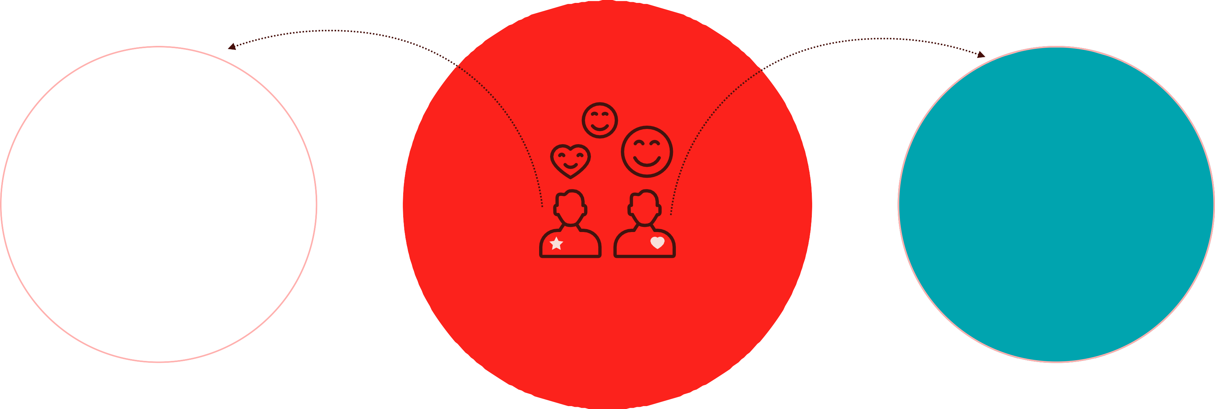
Consider your audience
Understanding their goals and needs
CLIENT
USERS
DELIVER
Storytelling is a Process

Slide 31

Forced Connection
Transform the ordinary into extraordinary
SERVICE/PRODUCT ATTRIBUTES
THE PROBLEM
UNRELATED ATTRIBUTES
Storytelling is a Process

Slide 32
Forced Connection
Smart Interface Design Patterns
users' needs
videos set
Vitaly’s role
tools
learning fast, getting the best lessons in UX/UI, and hungry for
knowledge.
experienced teacher, UX expert, guide
real-time examples, blackboard, notes, video courses,
and slides
a friendly and informal kitchen
Hungry users
Kitchen
Chef
Recipes
Storytelling is a Process

Slide 33
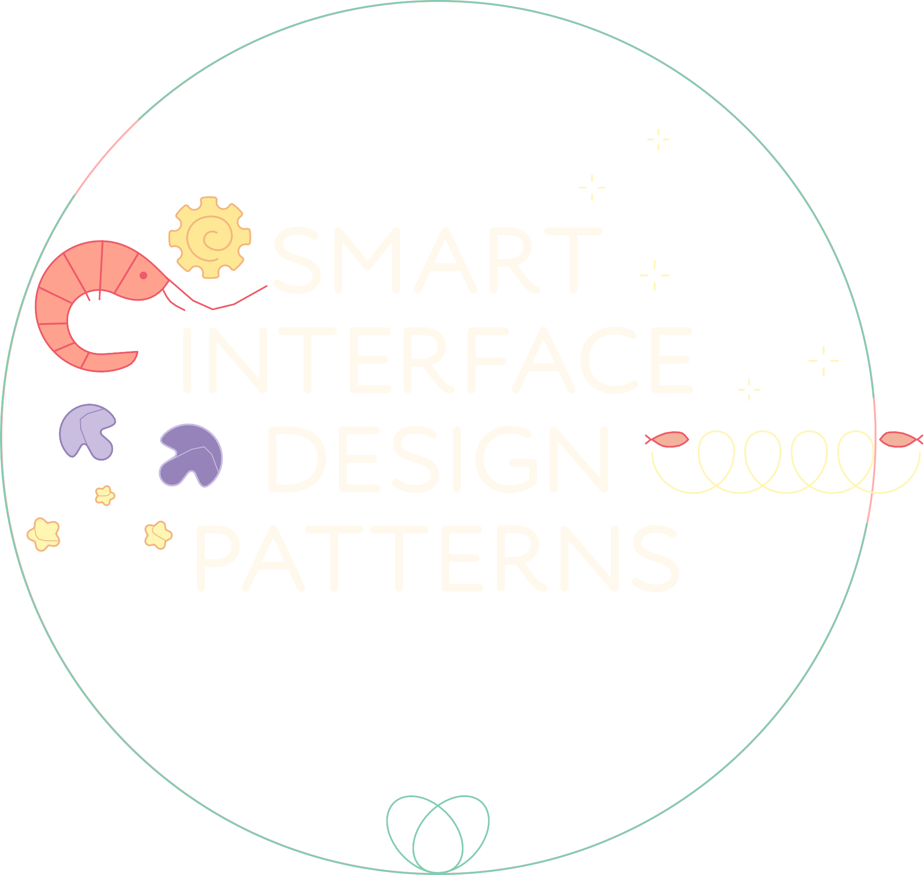



















Forced Connection
Smart Interface Design Patterns

Slide 34



































Forced Connection
Smart Interface Design Patterns

Slide 35


Forced Connection
Smart Interface Design Patterns

Slide 36










Forced Connection
Smart Interface Design Patterns

Slide 37
“One of the deep secrets of life is that all that is really worth the doing is what we do for others.”
Alice in Wonderland, Lewis Carroll

Slide 38

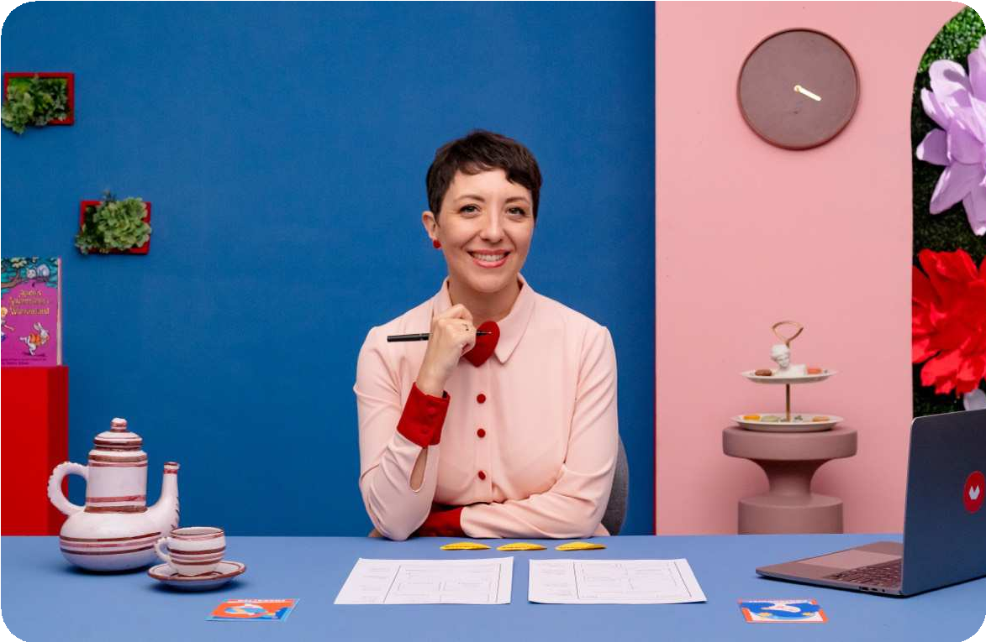
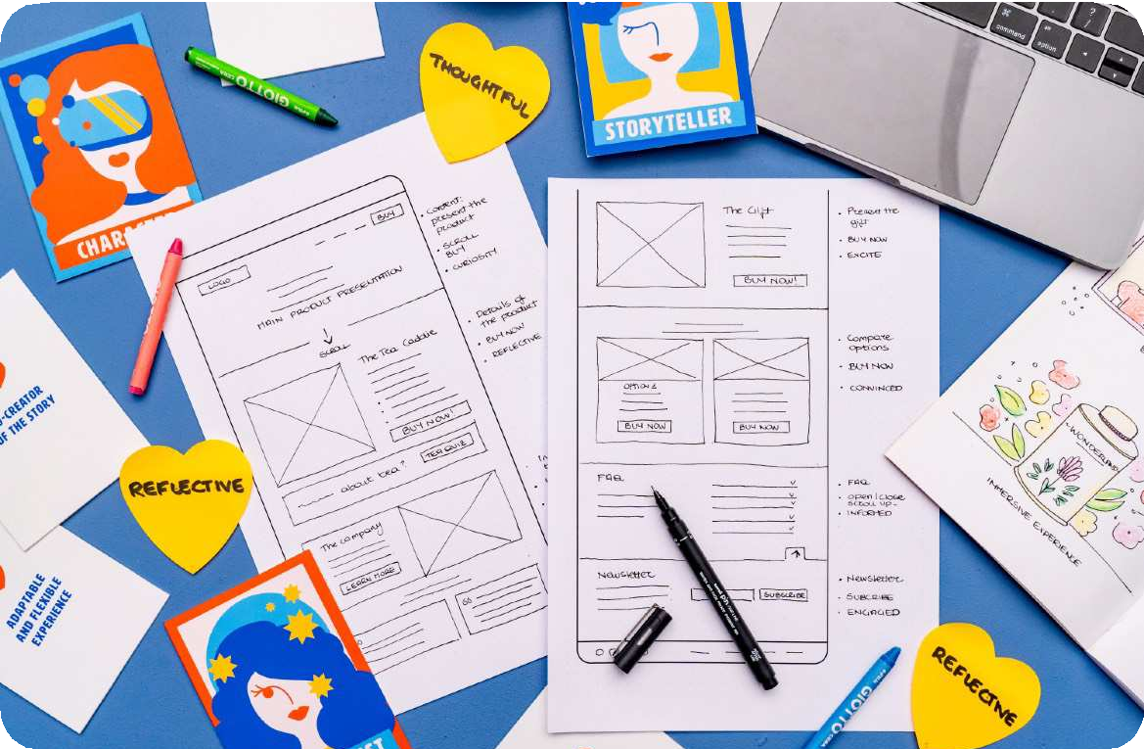


Online Course
For Beginner UX Designers and Storytellers
Ue Sunday Tales Newsletter
Tips and Stories for Strategic Storytellers
Ue Narrative Web Storytelling applied to UX/UI design
Available on Domestika.org
Ue Sunday Tales
Subscribe to my my biweekly newsletter, to receive it in your inbox every two Sundays!
https://www.domestika.org/en/courses/4898/chiara_10
https://www.untilsunday.it
Storytelling is a Process

Slide 39
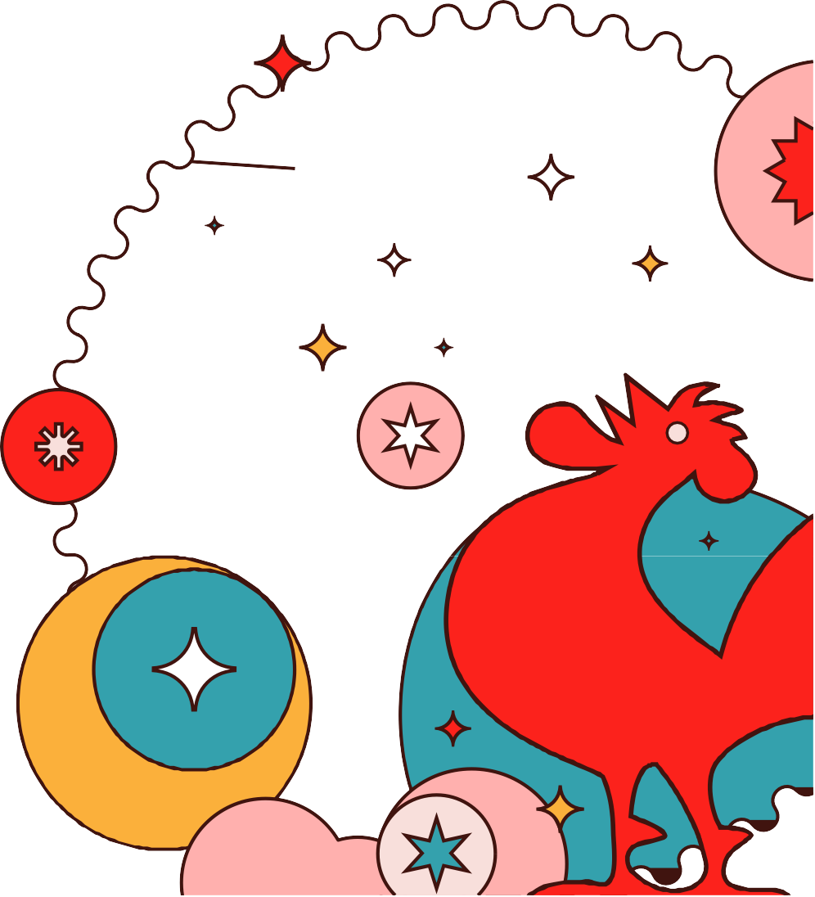

To be continued…
There is so much more I'd love to
share with you about storytelling!
Please follow me for the latest insights, on:
Instagram: @UntilSundayAgency
LinkedIn: Chiara Aliotta
Medium: chiara-aliotta.medium.com
www.untilsunday.it

